Slide 1
Teletype 101
May 15, 2011
Vintage Computer Festival East v.7
Bill Degnan
Midatlanticretro.org

Slide 2
Most popular mass storage?
The teletype (papertape) was the most popular mass storage device in early 1977 for microcomputers. Also served as an I/O station and printer.
IBM Punchcards very popular for minicomputers but not micros
Cassettes not yet prevalent
Disk drives and hard drives too expensive

Slide 3
Teletype Benefits
It’s slow, It’s noisy!
Easy to use – serial port w/ 20 milliamp current loop
It’s 4 devices in one – keyboard for console input, a printer for console display, and line printer, a tape reader for input and papertape punch for output.
$1000 refurbished unit, $1300 new with everything.

Slide 4
PaperTape Storage
Most popular in early 1977
“..it’s difficult to imagine that even one of you has never seen the media, or doesn’t know how paper tape operates…”
- Kilobaud Magazine

Slide 5
PaperTape Storage Specs
950 feet for $2.25 rolls, 1000 feet for fan folded for $4.50 (1977 $$)
1” wide, usually oiled
Stores 100,000 bytes per roll
Mylar tapes uses for master copies
Most papertapes can be read 25 times
Easily copied
Non-volatile (unless ripped)
Cannot be edited

Slide 6
PaperTape Storage Benefits
Punched papertape input/output
“papertape processing” – punching data to tape saves data in hard-copy form.
“tape reader” – senses and translated the holes into electric signals
“..perhaps best meet our criteria for program exchange…” can be read or duplicated and devices made by a dozen manufacturers.
In early 1977 you could not do that with other storage devices.

Slide 7
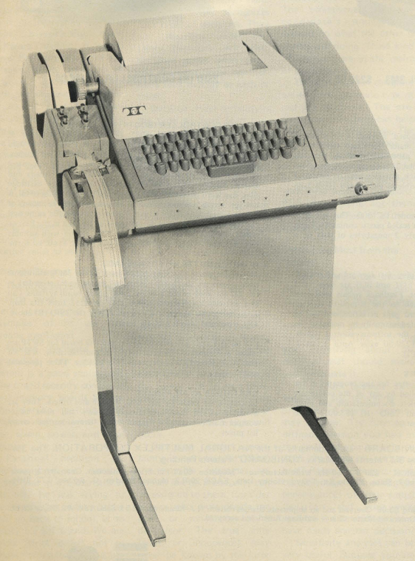
Teletype Model ASR 33
Introduced in 1962
470,000 produced from 1962 to 1976
ASR means automatic send-receive
ASR includes printer unit, keyboard send-receive, and paper tape reader and punch

Slide 8
Summary ASR 33
Teletype ASR 33
1” tape, ASCII, 110 baud
Speed: slow 10 cps – no more no less – a 4K program will take 1 hour to print
Ease of data recovery – simple
Volatility – good
Capacity – good enough
Transportability – good
Reliability – fair
Economy – Good because it’s a multi-function device.

Slide 9
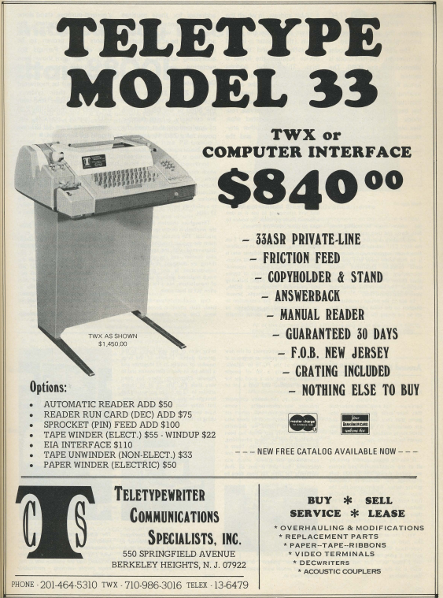

Slide 10
Teletype Model ASR 33
Most popular I/O device at dawn of microcomputing age
All mechanical
Operates by sending and receiving current impulses, a locic 1 being represented by a flow of current and a logic 0 by no flow.

Slide 11
Teletype Model ASR 33
Current levels for microcomputers usually 20 mA (milliAmps)
Transmission modes of Half and Full Duplex (full = ability to send and transmit simultaneously)
110 baud
Eleven pulses per ASCII character (8 data bits, plus one start and two stop bits)

Slide 12
Teletype Model ASR 33
Tape reader transmits whatever is on the eight levels of the tape in “parallel” because all of the feeler pins in the reader rise at the same time
Data is transmitted serially, one line for 8 bits = ASCII character
Limitation of the phone line system.
Must be 110 baud or timing fail = gibberish

Slide 13
Teletype Model ASR 33
Receiving is independent of the sending making full duplex possible
Stream of serial pulses arrives at the selector magnet drive that drives the selector cams, which set the desired ASCII code in a series of code bars – totally mechanical.
System is designed for ASCII code mechanically, but other codes are possible.

Slide 14
Other Alternatives
Creed 75 - $150
OP 80A – tape reader (very small) few moving parts to fail - $95 assembled. Faster than ASR 33
Fly Reader 30 – expensive and fast
Decitek
Flexowriter!

Slide 15
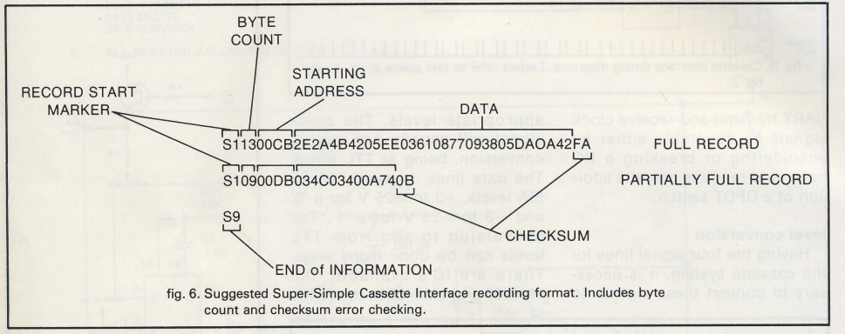
ASCII Teletype Format
See next slide for more details →

Slide 16
Here is the ending segment of a paper tape code segment. You can tell because the last line always has an S9 at the end of it:
S1131C102C20DEBD19217E167DBD185FD6259626A3
S1131C209B27C900D70297037E167DBD1999DE282C
S1131C30DF2C9C022742D6029603902DD22C2A1C1C
S1131C40D62C962DBD015ADF2CD6029603BD015A1F
S1131C509C2C2724A600BD02270820F4D602960354
S1131C60BD015ADF2ED62C962DBD015A9C2E270875
S1131C70A600BD02270820F47E167DDEDBDF027E8F
S1071C80167D0000C9
S9030000FC
Let's take a look at this line from the code above (3rd line from bottom): S1131C70A600BD02270820F47E167DDEDBDF027E8F
1. T he two-character byte count – how many 8-bit bytes there are to be expected in this line, in two char hex format INCLUDING the checksum = 13H
2 1C70 refers to the starting address in HEX of this line of code.
3. BD refers to the code in memory location 1C72
4. The two 7E's refer to the code in memory location 1C79 and 1C7F respectively
5. The byte count is 13 HEX = 19 in decimal notation. If you count all the pairs of numbers starting after the S113 (the first four chars) there are 19 dec pairs = 13 HEX.
6. The last two characters of every line is the checksum value, which is the one's complement of all 8 bit bytes ignoring carries.
You will not be asked to calculate the checksum, only id where it is.
The checksum is not part of the program code.

Slide 17
ASCII Teletype Format
S0 – leader (not shown in fig 6)
S1 – data
Break down of an S1 line:
S1 = “this is a line of data”
13 = “this is the two-character byte count – how many 8-bit bytes there are to be expected in this line, in two char hex format INCLUDING the checksum”
00CB = the starting address in hex
2E 2A 4B etc. is the data (2 char hex values)
NOTE: The checksum at the end of each line is the one’s compliment of the sum of all 8-bit bytes dropping call carries including the byte count, m address, and data. If the checksum is non-zero, an error is thrown by the monitor.
S9 – end of information indicator, stop the loader program (send signal through the AUX port of the tape cassette)
←See last slide for diagram

Slide 18
Picking out your ASR 33
Is it complete?
Is there rust?
Does it look like it was opened (to scrounge for parts)?
Did an animal make a nest inside?
Are the fuses present/blown?
Are all of the keys aligned correctly?
Print head ok?

Slide 19
Useful Stuff for Restoration
1. Basic toolkit, solderkit, wire stripper, electric tape, needle-nose plyers
2. Electricity measurement apparatus of choice
3. Various colored wire, 8 alligator chips, and/or a 4 or 6-wire cord that you can splice. Best Colors: green, white, black, red.
4. spade lugs - “the things that attach to the antenna screws at the end of a RF adapter" - you'll find these useful
5. EIA connect kit of choice if the computer you're attaching the teletype to has a 9-pin or 25-pin port. The little pins that often come in these kits are useful for testing.
6. 7/16 OD - 5/16 ID vinyl tubing (6 inches or more)
7. Cleaning supplies of choice - q-tips, paper towels, soap/water, canned air.
8. Extension cord
9. Notebook / camera to take picture before disassembly.

Slide 20
Replace Rubber Print Head Pad
Old print head pads will have turned to mush by now
Remove printer ribbon
Replace with a 7/8 inch long piece of 7/16 OD - 5/16 ID vinyl tubing.

Slide 21
Opening your ASR 33
There are three screws behind the metal “Teletype” strip in the front. You have to first remove the LINE/OFF/LOCAL knob then slide the strip down.
There is one screw that holds the cover on the left side by the papertape reader
There are three knobbed screws in the back
Remove the printer paper advance knob
Carefully remove cover, avoid the papertape reader lock.

Slide 22
Check the Comm. Settings
Most of the time you want to set your TTY for 20mA current loop and full duplex. 1. The large, green, flat resistor on the TTY base near the call control unit (a flat 4-post resistor with a blue wire on post #4) 2. Set purple wire to contact 9 of the terminal strip 3. Set brown-yellow wire on terminal strip post 5 4. white-blue wire on terminal strip post post 5 also Terminal input to the teletype to contact 6 for negative line and 7 for the positive line. (printer punch) Terminal output (keyboard - reader) contacts 3 and 4 (not polarity sensitive)

Slide 23
Two ways to connect to computer
Plug In connectors (molex)
Terminal Strip
You can bypass the connector by attaching the 4 wires from the computer directly to the terminal strip. The terminal strip is located behind/below the connectors.
If you're making a cable with a special connector to match your particular computer card EITHER the terminal strip or #2 connector can be used. You can have something attached to both, just not at the same time (or you’ll get crazy results).

Slide 24
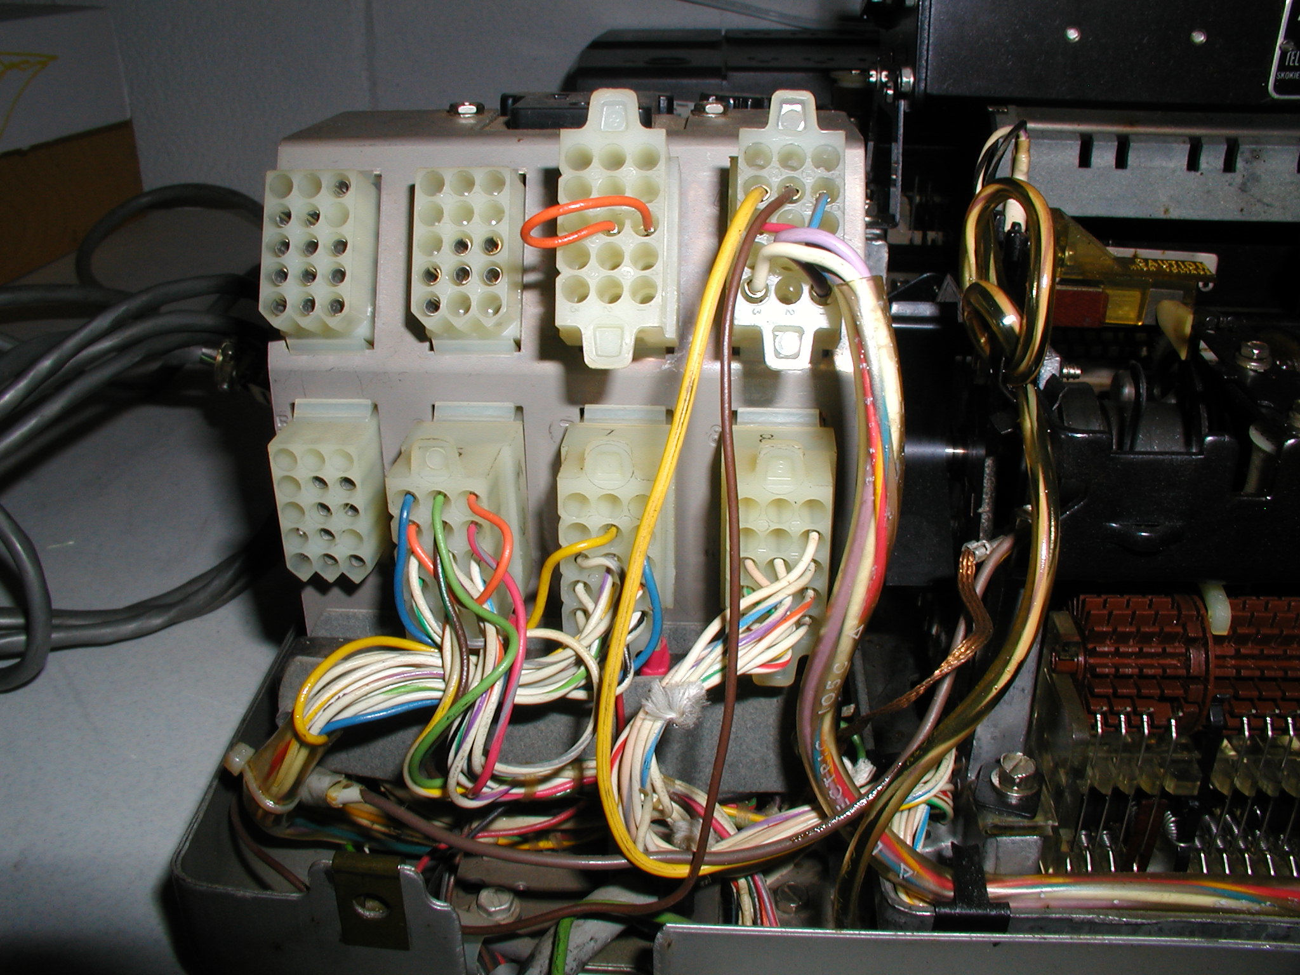
Plug in (molex) connectors. The computer connects to connector 2, which is second from the top left.

Slide 25
Plug In Connectors
8 connectors behind the call control unit (near the three fuses). The top left is #1, bottom right is #8. #2 connects to the computer.
Pin hole one is located at bottom right, see array below: 15-14-13 12-11-10 09-08-07 06-05-04 03-02-01

Slide 26
Number Two Connector
Transmitted data return (-) attaches "number 2 connector" #7
Received data return (-) attaches to num 2 connector #5
Transmitted data send (+): #2 connector 8
Received data send (+): #2 connector #6.

Slide 27
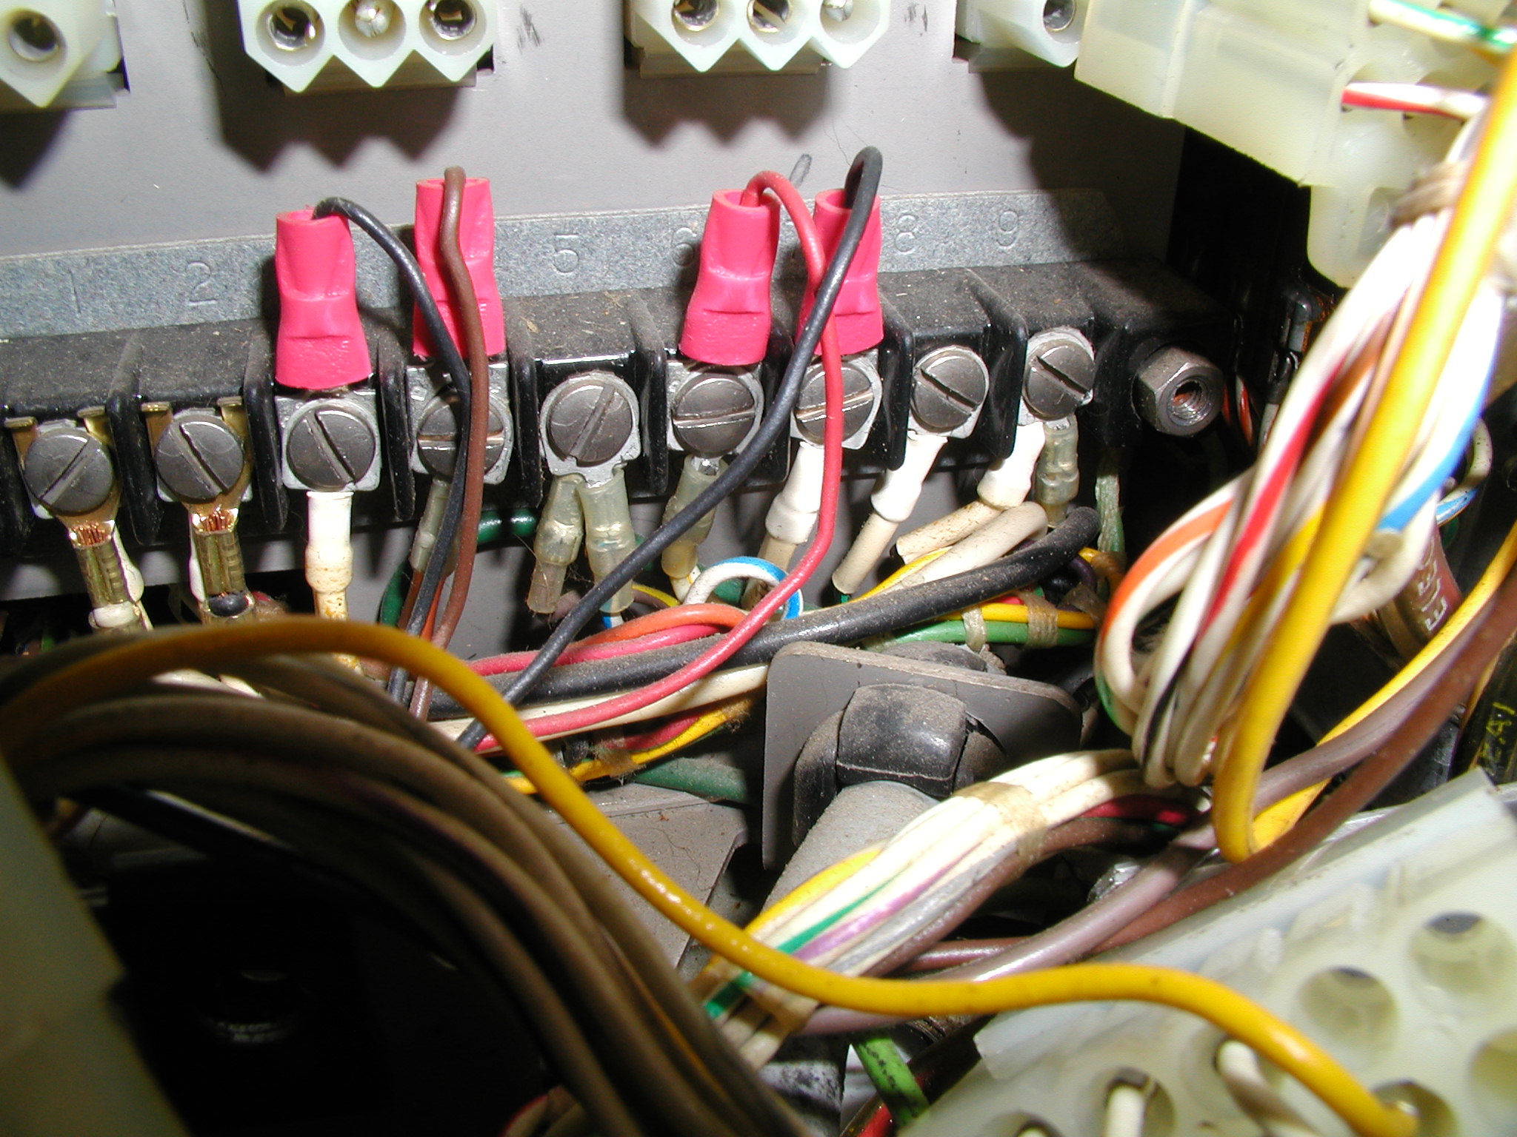
Terminal Strip is located behind the plug in connectors of the UCC-6

Slide 28
The Terminal Strip
If you remove the 8 plug-in connectors and the fiber strip cover, you'll reach the terminal strip of an asr 33.
The four posts of the terminal strip: 3,4,6,7 have connectors above their respective terminal's screw post. These four wires travel through the reader control and eventually out to the computer.

Slide 29
Wiring the Terminal Strip
Transmitted data return (-) attaches to terminal strip screw 6 Received data return (-) attaches to terminal strip screw 3 Transmitted data send (+): Terminal Strip 7 received data send (+): Term strip 4

Slide 30
